Slide 1
AmpliFund Workflow Enhancements
Grant Seeker
May 19, 2025

Slide 2
Welcome!
Agenda
Highlights of Functionality
In-Product Demonstrations
How to Build a Workflow
How to Enroll Payment Requests in a Workflow
Question and Answer portion
Format
Mics are muted
Q & A Feature in Zoom available
Training recorded and to be shared on ZenDesk

Slide 3
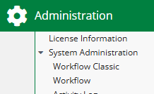
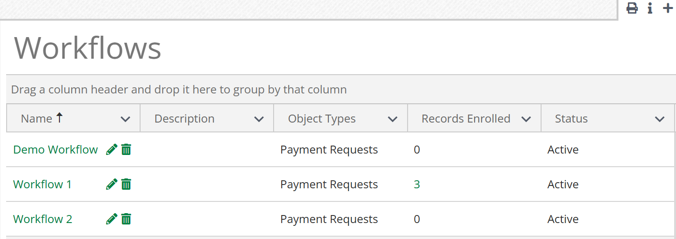
Key Changes
Classic
The new workflow engine has been created as a new sub-menu: Workflow. Previous sub-menu has been renamed Workflow Classic.
Payment Requests can be enrolled and routed through a Workflow for review.
Workflow Queues have been removed.
Ability to assign default assignees by user, role (such as Manager or Additional user) and department.
Payment Requests can be Approved or Rejected through Workflow Automation.
New

Slide 4
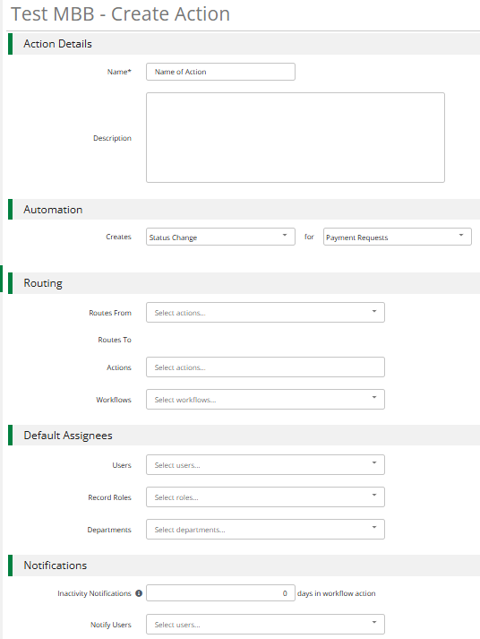
Building a Workflow
Name and Description of our Action.
Set up the Status Change for your Object/Payment Request.
Build the Routing Steps and Actions.
Select Assignees by User, Record Roles, and Departments.
Optional – Set up Inactivity Notifications for certain users.

Slide 5
Actions Configuration

Slide 6
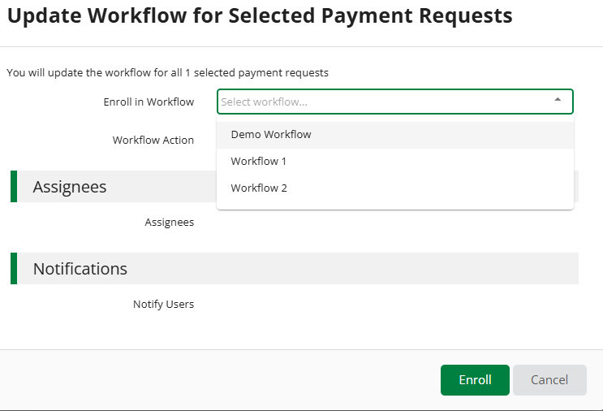
Enrolling in a Workflow

Slide 7
Actions with Enrolled Payment Requests

Slide 8
In-Product Demonstration

Slide 9
Other Future Releases within Workflow
Activity > Workflow Actions
Available 5/30
Additional Objects to enroll, including Amendments, Payment Authorizations, and Grants
Available 6/30
Reporting Categories
Available 6/30
Required Field Validation
By 7/4

Slide 10
Thank you for your time!
Available on ZenDesk later this week:
Today’s recording
Supplemental documentation, including a guide and FAQ sheet
Other Training:
New Payment Request Workflow – Build with Me Session:
Join us to build your Workflow in real time
Wednesday, June 4 @ 1-2pm ET
Register on ZenDesk or through the Resource Center in AmpliFund
Please contact your Customer Success Representative for any further questions.

