Slide 1
Recipient Training
[Date]

Slide 2
Agenda
Welcome & Introductions
Getting Started with AmpliFund
AmpliFund Navigation & Account Overview
Accessing Grant & Updating Budget
Tasks to Complete
Expense Entry & Payment Request Submission
Performance Achievement & Performance Reporting Period Submission
Amendment Request Submission
Available Reporting
Support Resources
Q&A

Slide 3
Supported Browsers
Google Chrome (current supported releases)
Mozilla Firefox (current supported releases)
Microsoft Edge (current supported releases)
Apple Safari 10+
For the best experience we encourage the use of Google Chrome

Slide 4
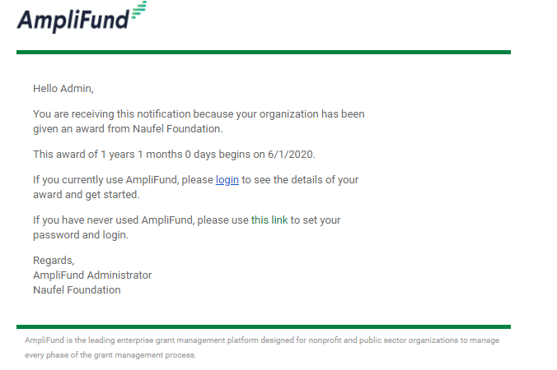
Award Activation
Account owner will use this link to set-up log-in and can add additional users.
Funder name
#
#
Award Start Date
Funder name
Award activation emails will be sent in the coming days

Slide 5
In-Product Review

Slide 6
Summary of Required Actions
Administration: Log-in to AmpliFund & add relevant user to your account and invite them
Grant Management: Update the Recipient Grant Manager
Activity: Enter Expenses
Post Award Management: Submit Payment Request
Activity: Mark Budget Reporting Period Task as Complete
Activity: Enter Performance Achievements
Post Award Management: Close Performance Reporting Period
As Needed:
Sync calendar with AmpliFund
Review available reports
Register on the AmpliFund Support Site

Slide 7
Support

Slide 8
AmpliFund Support
Submit a support ticket:
support@amplifund.zendesk.com
Visit the support portal:
https://amplifund.zendesk.com
Supported Browsers:
Google Chrome (current supported releases)
Mozilla Firefox (current supported releases)
Microsoft Edge (current supported releases)
Apple Safari 10+

Slide 9
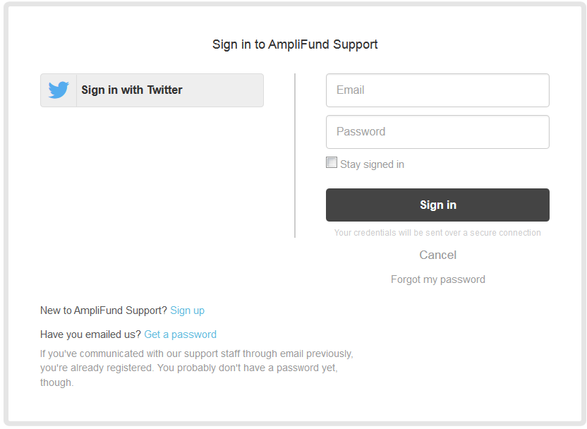
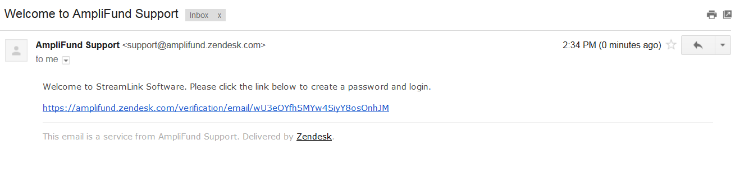
AmpliFund Support Site
Go to https://amplifund.zendesk.com
Click the Sign up link
Enter your full name
Enter your email address
Complete the I’m not a robot check
Click the Sign up button
A welcome email from support@zendesk.com will be sent to you via email
Click the link to set your password

Slide 10
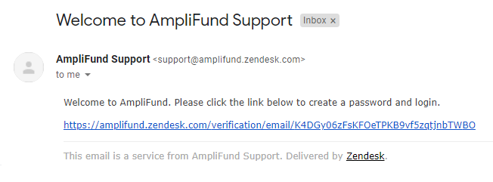
Welcome to AmpliFund Support

Slide 11
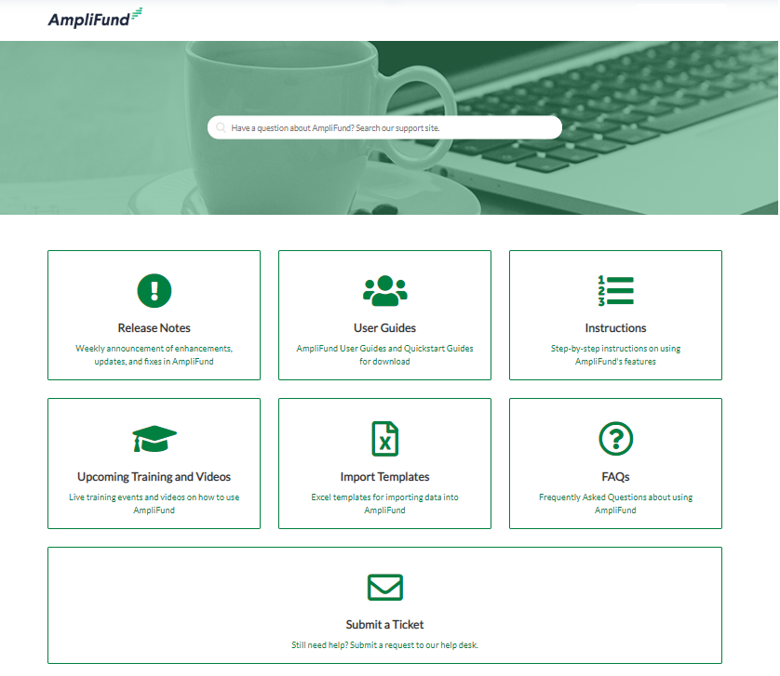
AmpliFund Support Site

Slide 12
Thank You
www.gotomygrants.com

Slide 13
Appendix
Support Slides

Slide 14
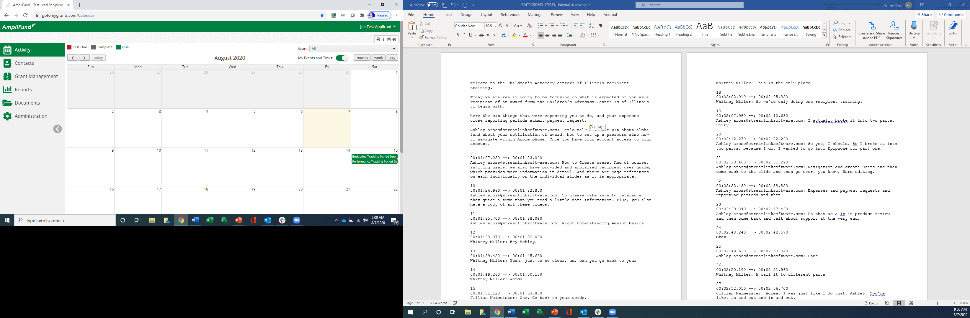
Navigating AmpliFund
2
3
Left Navigation -shows on every page
User Navigation –includes account information, change password, message center, support, terms and conditions, applicant portal, and logout
Options Toolbar –displays icons to perform functions available on the current page, icons vary based on page
1
1

Slide 15
Adding Users

Slide 16
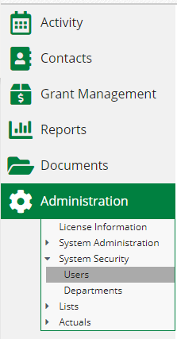

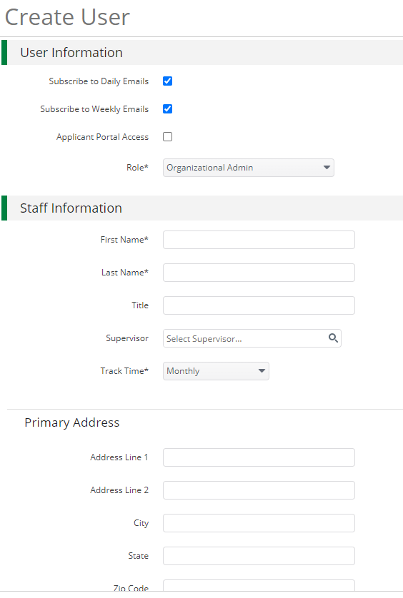
Creating Additional Users
1
Open Administration > System Security > Users
Click the + icon in the top right hand corner to create a User
Enter user preferences & information
  Select the User’s Email Preference
  User role
  User’s First Name, Last Name, and E-Mail Address
Click the ‘Create’ button
2
3

Slide 17
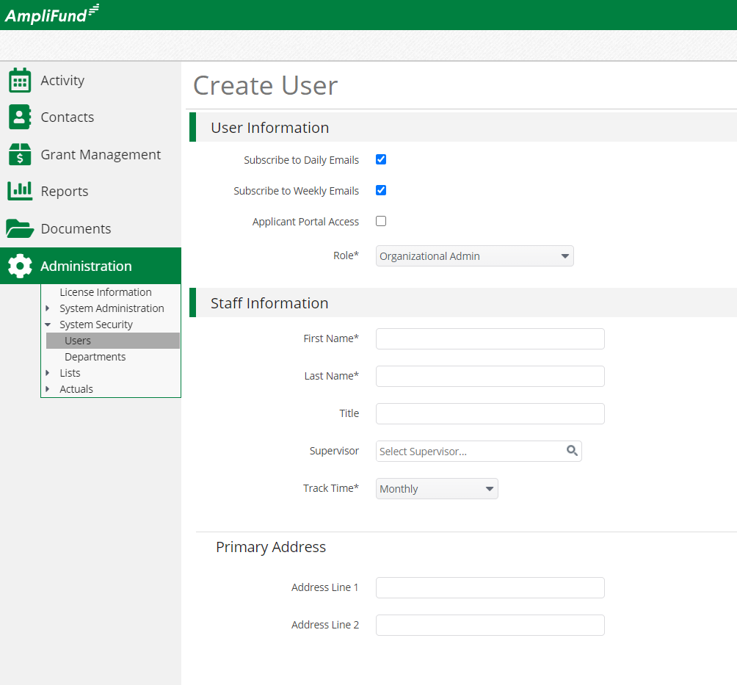
User Options
Subscribe to Daily/Weekly Emails
  Set to Yes to receive daily and/or weekly emails from AmpliFund with tasks/reminders
Applicant Portal Access
  Set to Yes to provide a user in your organization with access to submit applications
Role*
  Organization Administrator
    Full view and edit access to your organization’s AmpliFund account
  Executive
    View only access to your organization’s AmpliFund account
  Department User (No Salary)
    Only has access to budget or performance plan items to which you assign the user as the Responsible Individual
  Department User (Salary)
    Has access to budget or performance plan items to which you assign the user as the Responsible Individual including personnel line items

Slide 18
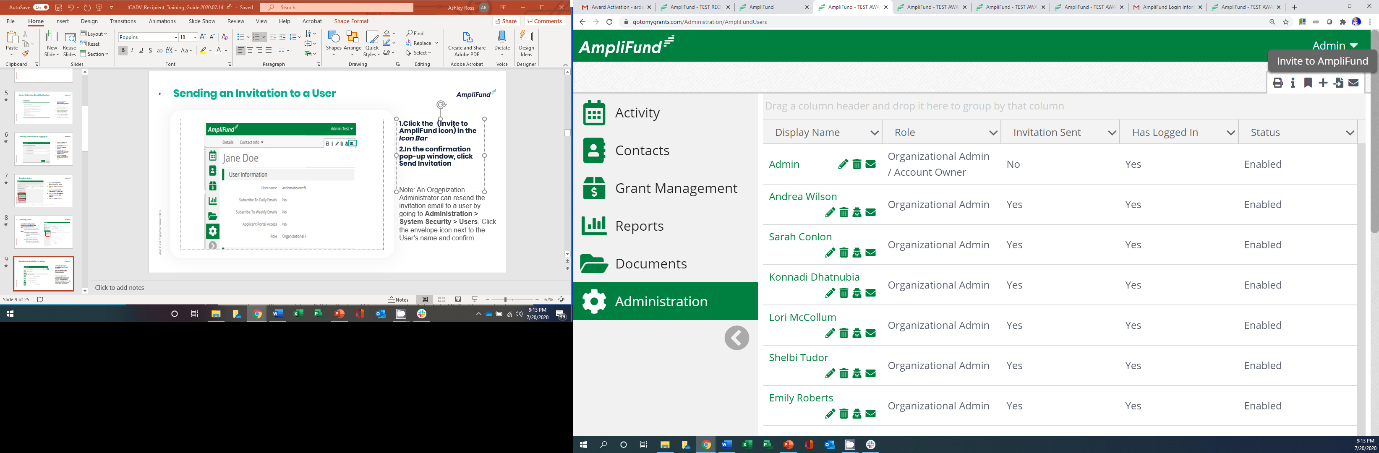

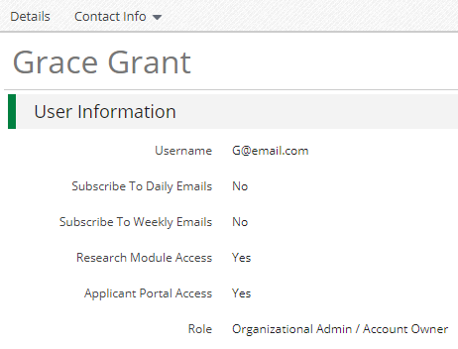
Sending an Invitation to a User
Click the in the Icon Bar
In the confirmation pop-up window, click Send Invitation
Link is active for 72 hours
Note: An Organization Administrator can resend the invitation email to a user by going to Administration > System Security > Users. Click the envelope icon next to the User’s name and confirm.

Slide 19
Updating Grant Award

Slide 20
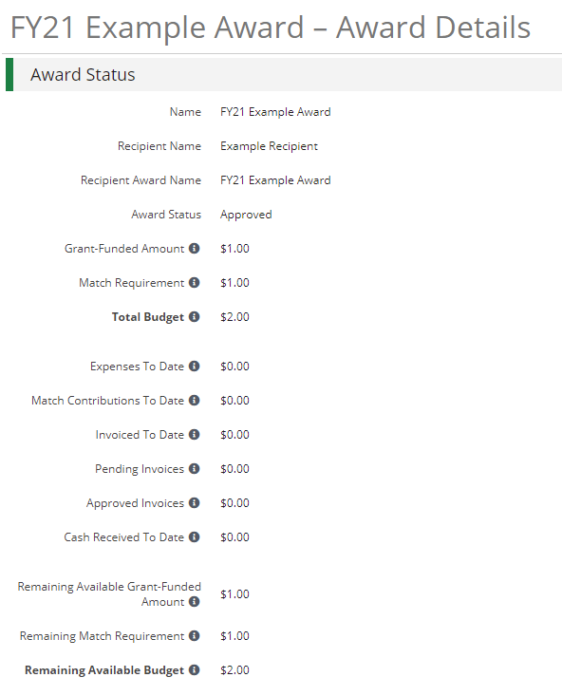

Updating Grant Award Details
Go to Grant Management > Grants
Click the ‘pencil’ icon next to grant name to edit
Update the Recipient Grant Manager name & add Recipient award name (optional)
Click the Save button in the right corner of the screen
3
1
2
Grant Performance Plans and Budgets have already been created in your account.
*Page 10 of the AmpliFund Recipient User Guide

Slide 21
Accessing Budget

Slide 22
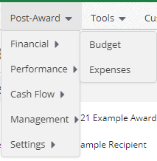
Accessing Budget
Go to Grant Management > Grants
Click the grant name
Click on Post Award>Financial>Budget
3
1
2
Grant Performance Plans and Budgets have already been created in your account.
*Page 10 of the AmpliFund Recipient User Guide

Slide 23
Expense Entry

Slide 24
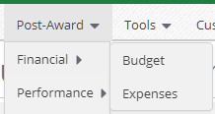
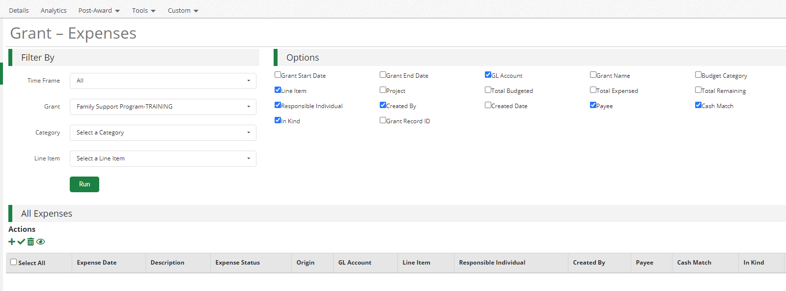
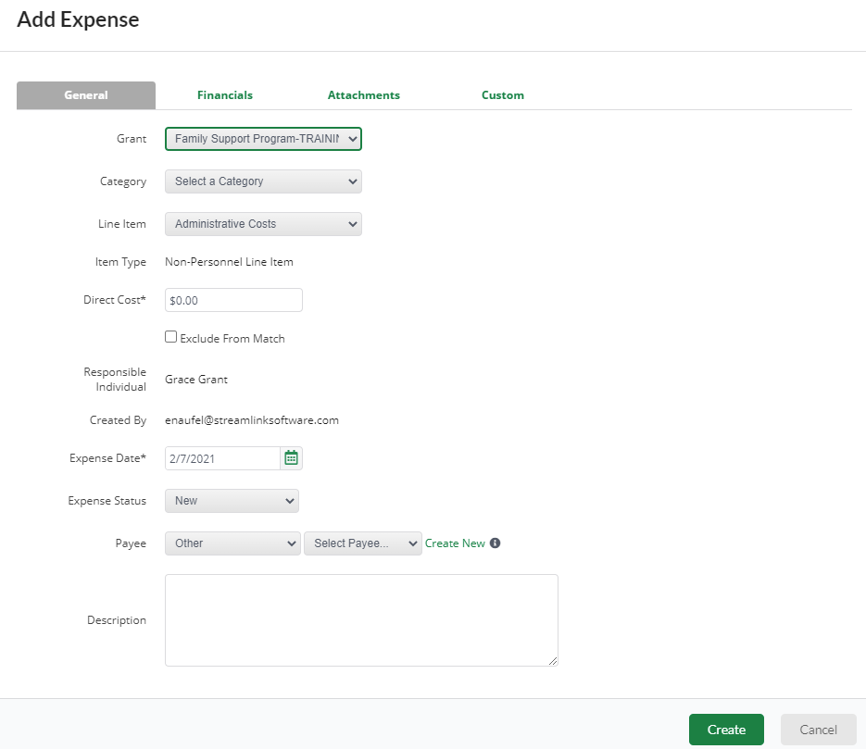
Expense Entry
From the Grant click on Post Award>Financial> Expenses
Click on the plus icon to add a new expense
Add expense information under expense tab then click Create
1
2
3

Slide 25
Submitting a Payment Request

Slide 26
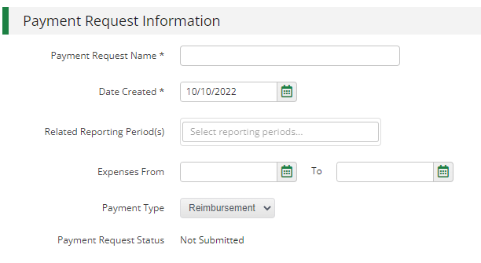
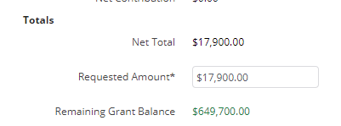
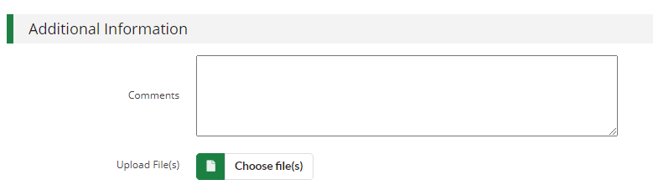

Generating a Payment Request from Reporting Period
Post Award>Cash Flow>Payment Requests
Enter name, date created and time period
Type in total requested amount
Add any additional comments & upload files to Funder
Click submit to send to Funder
1
2
3
4
5

Slide 27
Creating & Submitting Performance Achievements

Slide 28
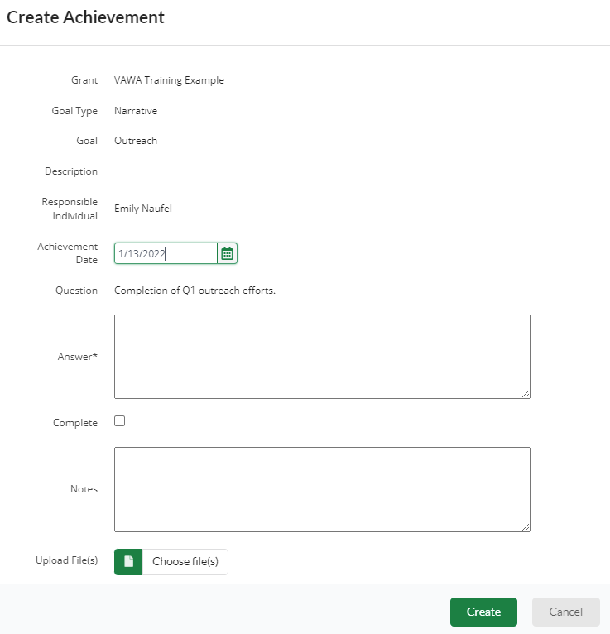
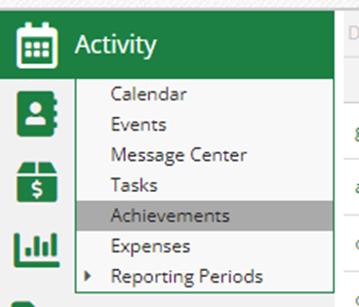

Creating Performance Achievements
Click on Activity then Achievements
Click on the plus icon next to the goal
Enter information about performance achievement and click Create
Repeat for each relevant goal
3
1
2

Slide 29
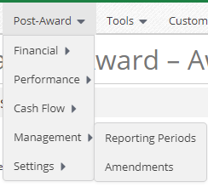
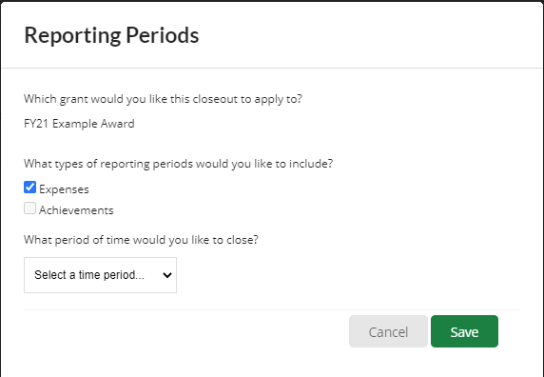

Generating a Performance Reporting Period
From the Grant click on Post Award>Management>Reporting Periods
Click on the plus icon in the upper right hand corner
Select Achievements and Time Period then click Save
Review achievements & details, click Close to send completed reporting period to Funder
2
1
3
4

Slide 30
Available Tools

Slide 31
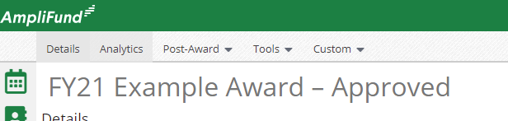
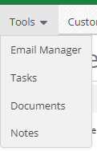
Available Tools
From Grant Record Select Tools

Slide 32
Available Reporting

Slide 33
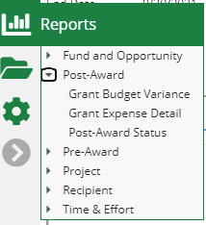
Available Reporting
Grant Dashboard
Other Reports

