Slide 1
Applicant Training
[Date]

Slide 2
Agenda
Welcome & Introductions
Getting ready to register on the AmpliFund Applicant Portal
Applicant Portal Demonstration
Navigation Overview
Opportunity Review
Application Process Review
Administration Section
Q&A

Slide 3
Supported Browsers
Google Chrome (current supported releases)
Mozilla Firefox (current supported releases)
Microsoft Edge (current supported releases)
Apple Safari 10+

Slide 4
User Registration Basics
User registration is required to:
Save an opportunity
Apply for an opportunity
Information you’ll need to register:
Email address
Contact information
Organization contact information
What happens next?
Accept the terms & conditions then you’ll have full access to the applicant portal
To enable collaboration across your organization one user should set up the organization and invite users

Slide 5
Applicant Portal Demonstration

Slide 6
Q&A

Slide 7
Applicant Video Resources
AmpliFund Applicant Portal: New User Registration
AmpliFund Applicant Portal: Applicant Portal Navigation
AmpliFund Applicant Portal: Opportunity Overview
AmpliFund Applicant Portal: How to complete an application
AmpliFund Applicant Portal: How to complete a budget template
AmpliFund Applicant Portal: How to complete a performance plan template
AmpliFund Applicant Portal: Applicant Portal Administration Section
AmpliFund Applicant Portal: Application Status - View, Withdraw, Delete
AmpliFund Applicant Portal: Returning to the Applicant Portal
AmpliFund Applicant Portal: Application Revision

Slide 8
Key administration section features
View applications
Update account information
Add users
Access FAQ

Slide 9
Key steps to complete an application
Click
Complete Project Information
Complete Application form(s)
Complete Budget template
Mark each section as Complete
Review & Download Application (if desired)
Click Submit
=

Slide 10
Application Progress Bar

Slide 11
Application Tips
You can complete the application sections in any order
Click on the circle of a section to navigate to that section
You must hit Save or Mark as Complete to save your work
If you’ve marked a section as “Mark as Complete” you can go back and edit that section by hitting “Mark as in Progress”
Every section must be marked as complete to submit your application
Submitted applications cannot be edited, you may withdraw but would need to complete a new application

Slide 12
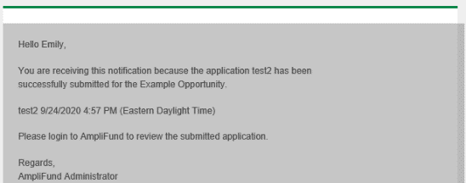
Application submitted email confirmation

